Slide 1

Department of Computer Science & Engineering Artificial Intelligence & Machine Learning
A.P. Shah Institute of Technology G.B.Road,Kasarvadavli, Thane(W), Mumbai-400615
UNIVERSITY OF MUMBAI
Academic Year 2024-2025

Slide 2

Solving ODE using AI techniques
Computer Science & Engineering Artificial Intelligence and Machine Learning By
Sumeet Gupta (22106071)
Chavez Anthony (22106038)
Kshitij Chitnis (22106078)
Mohammed Ali Bardi(22106058)
Under the Guidance of Prof. Nirali Arora

Slide 3

Index
INTRODUCTION
OBJECTIVES
LITERATURE SURVEY
TOOLS USED
BLOCK DIAGRAM
STRUCTURE OF RNN
IMPLEMENTATION
CONCLUSION
REFERENCES

Slide 4
Introduction
Ordinary Differential Equations (ODEs) are essential in modeling dynamic systems, but traditional methods for solving them can be computationally expensive and inaccurate for complex problems.
In this presentation, we explore the use of Residual Neural Networks (ResNet) as an efficient ODE solver. By leveraging the power of deep learning, ResNets can model complex, nonlinear relationships and provide a more accurate and scalable approach to solving ODEs compared to traditional methods.

Slide 5

Objectives
Develop an understanding of ODEs.
Understand the concept of residual connections in deep learning.
Demonstrate how RNNs can be used as solvers for ODEs.
Show how neural networks, particularly residual networks, can approximate the solutions of ODEs.
Compare the effectiveness of neural network-based methods with traditional ODE solvers (e.g., Runge-Kutta).
Discuss improvements in solving stiff equations and high-dimensional systems.
Explore adjoint sensitivity and backpropagation through ODE solvers.

Slide 6
Literature Survey
PAPER NAME | AUTHOR | YEAR | DESCRIPTION
Physics-Informed Neural Networks: A Deep Learning Framework for Solving Forward and Inverse Problems Involving Nonlinear Partial Differential Equations | M. Raissi, P. Perdikaris. | 2015 | This paper introduces physics-informed neural networks (PINNs) as a unified deep learning framework for solving forward and inverse problems involving nonlinear partial differential equations..
Deep Residual Learning for Image Recognition | K.He, X.Zhang,S.Ren | 2016 | Although this paper primarily focuses on image recognition, it introduces deep residual learning, which has been foundational in developing neural network architectures for approximating differential equations.

Slide 7
PAPER NAME | AUTHOR | YEAR | DESCRIPTION
Neural Ordinary Differential Equations | R.T.Q. Chen, Y. Rubanova | 2018 | This paper presents neural ordinary differential equations (Neural ODEs), a continuous-depth model inspired by residual networks.
Diffusion Mechanism in Residual Neural Network: Theory and Applications | L. Zhang, G. Zhang, and Z. Li | 2023 | inspired by the convection-diffusion ordinary differential equations (ODEs), this paper proposes a novel diffusion residual network (Diff-ResNet). The authors analyze the diffusion mechanism in residual neural networks and demonstrate its applications in image recognition tasks.

Slide 8


Tools/softwares, Languages used
Visual Studio Code
Python

Slide 9
Block Diagram
Start
Define ODE to
be solved
For forward pass
Use ODEint
backpropagation
yes
Visualize the
trajectories
Optimize loss
function
Use adjoint method?
no
Compare with actual solution
End

Slide 10
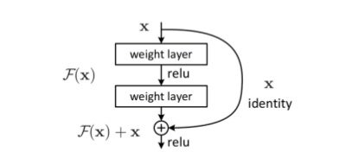
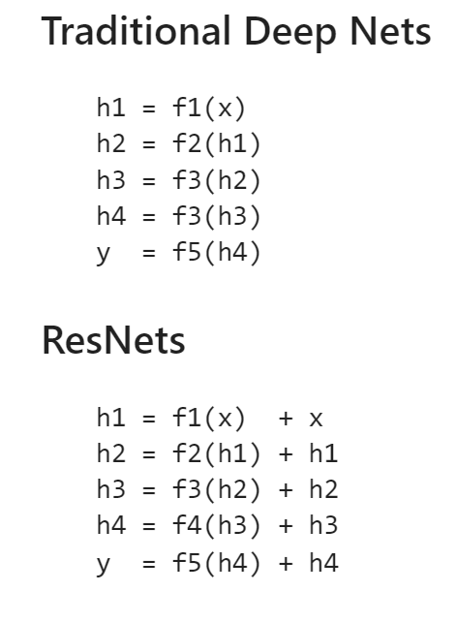
Structure of RNN

Slide 11
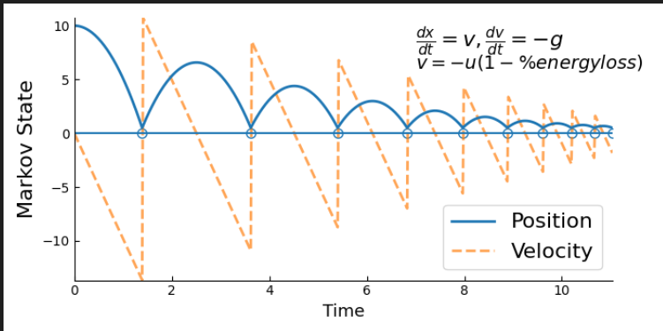
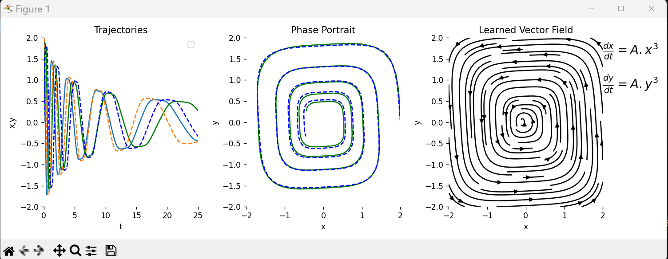
Implementation

Slide 12
Conclusion
We presented an RNN-based approach for solving ODEs using the adjoint method.
The model dynamically determines its structure, eliminating the need to predefine the number of layers.
The adjoint method ensures memory efficiency while providing accurate gradient computations.
Our approach adapts well to complex dynamical systems, enhancing computational efficiency.
Future work could explore extensions to stochastic differential equations and hybrid physics-informed models.

Slide 13
References
[1] M. Raissi, P. Perdikaris. "Physics-Informed Neural Networks: A Deep Learning Framework for Solving Forward and Inverse Problems Involving Nonlinear Partial Differential Equations." IEEE Transactions on Neural Networks and Learning Systems, vol. 30, no. 9, (2019), pp. 123-136.
[2] K.He, X.Zhang,S.Ren. "Deep Residual Learning for Image Recognition." Proceedings of the IEEE Conference on Computer Vision and Pattern Recognition (CVPR), (2016), pp. 770-778.
[3] R.T.Q. Chen, Y. Rubanova, J. Bettencourt. "Neural Ordinary Differential Equations." Advances in Neural Information Processing Systems (NeurIPS), (2018).

Slide 14
[4] L. Zhang, G. Zhang, and Z. Li. "Diffusion Mechanism in Residual Neural Network: Theory and Applications." IEEE Transactions on Pattern Analysis and Machine Intelligence, (2023).
[5] X. Li, Y. Chen, and W. Cai. "Attributes of Residual Neural Networks for Modeling Fractional Differential Equations." Heliyon, vol. 9, no. 1, e12345, (2023).
[6] Y. Yang, J. Sun, and M. Chen. "Physics-Informed Neural Networks for Solving Differential Equations." arXiv preprint arXiv:2408.10011, (2024).
[7] J. Baggenstos and D. Salimova. "J. Baggenstos and D. Salimova." arXiv preprint arXiv:2111.00215, (2021).

Slide 15



